Slide 1



‘21
Organized by
Rajasthan Institute Of Engineering And Technology Jaipur
(Affiliated to Rajasthan Technical University, Kota and Approved by AICTE, New Delhi)
26th June 2021
Project Name: Vehicle Counting using VANET
Team Name: Aura
Team Leader-Aleena Sara Varghese
Team members- Harsha Daniel
Sindhoora
Sreeram M
Technology Name: VANET

Slide 2
PROBLEM STATEMENT
The growing density of vehicles on the roads of most towns and cities around the world is becoming a hazard.
This growth leads to traffic congestion on the roads, resulting in negative effects on traveling time, traffic safety, air pollution, noise pollution, and energy consumption. Therefore, controlling and optimizing the vehicular flows is a major task.
Before dealing with a complex problem as the optimization of vehicular traffic, we must understand the behaviour of traffic flow through some models.
A specific problem to be solved is the development of algorithms to optimize the cycles of traffic lights of a set of intersections and thus achieve a greater vehicular flow with fairer waiting times for all vehicles.

Slide 3
EXISTING SOLUTIONS
INDUCTIVE LOOP DETECTORS
ILDs are most widely used sensor for collecting traffic data and are commonly used for detection at traffic signals and for freeway monitoring.
DRAWBACKS
ILDs require regular tuning to ensure that speeds and vehicle classification data are of high quality. Maintenance and installation of ILDs can be problematic, particularly in congested urban areas.
If an ILD needs to be replaced, an entire lane of road would need to be closed so that the loop could be cut out and reinstalled.
VIDEO DETECTING SYSTEM
Video detection systems uses cameras and image processing software to collect data on traffic flow. In this a camera is pointed at a roadway, and image processing software analyses pixels changes between successive frames.
DRAWBACKS
Most important problem with video detection is occlusion. Occlusion occurs when a vehicle obscures another vehicle within the camera’s field of view. Occlusion causes undercounting of traffic volumes or poor speed calculation.
Difficult for periodic maintenances such as cleaning camera lenses
Fog and snow create problems with the video processing software and is also affected by high winds

Slide 4
PROPOSED SOLUTION
Existing technologies- Complex to install, and they suffer a high economic cost caused by both installation and recurring maintenance.
Solution-VANET technology seems to be a good option for vehicle counting and should become ubiquitous promptly since it is estimated that all vehicles will be equipped with a WAVE device within the next few years.
Knowing the number of vehicles on the road can help estimate the occupation in a certain road section, or propose a dynamic schedule for the traffic lights at an intersection, etc.
We obtain the count of the vehicles through communication between vehicles and RSU. The algorithm for counting and the simulation of vehicles were developed using OMNeT++, SUMO and Veins.
The technology and algorithm is highly adaptive and can be incorporated for various purposes such as accident detection or for paving a path for emergency vehicles such as ambulances.

Slide 5
SIMULATION ENVIRONMENT
Simulation of Urban mobility (SUMO) : Open-source traffic simulator to generate traffic pattern.
Key features : Collision free vehicle movement, multi-lane street environment, junction-based right-of-way rules
OMNET++ : C++-based discrete event simulator for modelling communication networks, multiprocessors and other distributed or parallel systems.
The network structure of modules is illustrated using a special language, known as NEtwork Description (NED) language.
Simulation executions are easily configured via initialization files (*.ini files) that are configured prior to the simulation run.
VEINS: Integrated network and traffic simulator.
Veins make a TCP connection between SUMO and OMNeT++ and it can simulate traffic and network.

Slide 6

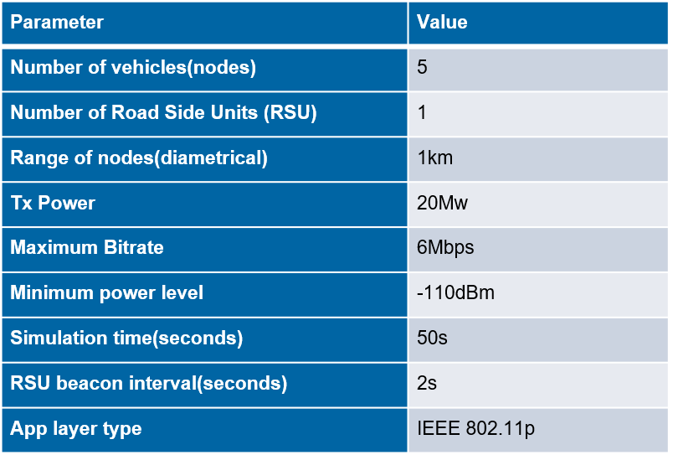
SIMULATION SETUP
SUMO- Vehicles approaching intersection
Simulation Configuration

Slide 7
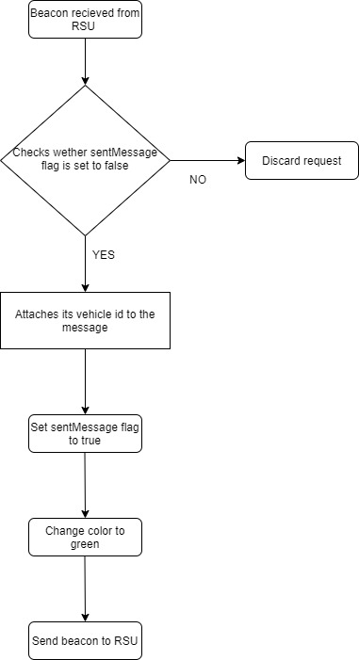
ALGORITHM

Slide 8
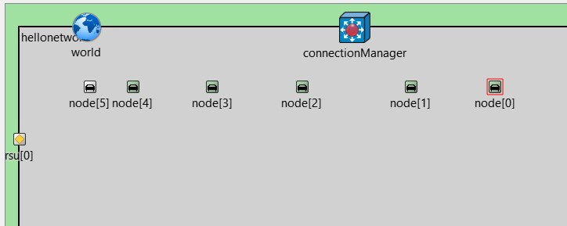
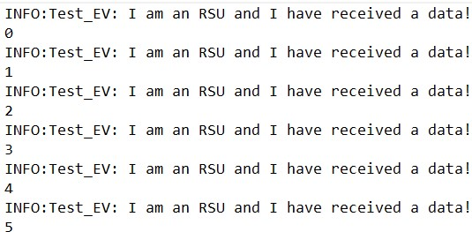
OMNeT- position of RSU and nodes (with id)
Count obtained by RSU

Slide 9
MERITS
The speed and choice of path defines the dynamic topology of VANET.
VANET’s topology is extremely dynamic as vehicles go in and out transmission range quite rapidly.
Large coverage area.
Vehicles act as mobile power plants. Thus, power consumption is not a concern.
Interaction with onboard Sensors: These sensors help in providing node location and their movement nature that are used for effective communication link and routing purposes.
Vehicular ad hoc network is one of the most interesting research areas due to low cost, flexibility, fault tolerance, creating many new and exciting application areas for remote sensing.

Slide 10
APPLICATIONS
This algorithm can be used as a basic tool in the development of Adaptive Traffic Control Systems (ATCSs) and should dramatically help to optimize vehicular flow.
Road Transportation Emergency Services – where VANET communications, VANET networks, and road safety warning and status information dissemination are used to reduce delays and speed up emergency rescue operations to save the lives of those injured.
Traffic information systems, which use VANET communication to provide up-to-the minute obstacle reports to a vehicle's satellite navigation system
Electronic brake lights, which allow a driver (or an autonomous car or truck) to react to vehicles braking even though they might be obscured (e.g., by other vehicles).

Slide 11
CONCLUSION
The simulations that we performed show that our algorithm calculates a total number of vehicles, with very low response times and small numbers of control messages sent by the units during the counting.
Improving the algorithm in such a way that the total number of vehicles in a parking lot can be calculated and assisting in finding a vacant slot.
We plan to enhance our algorithm by dividing roads into multiple lanes and obtaining the data to control traffic light system.

Slide 12
THANK YOU

